Slide 1

Solution PyBank results

Slide 2
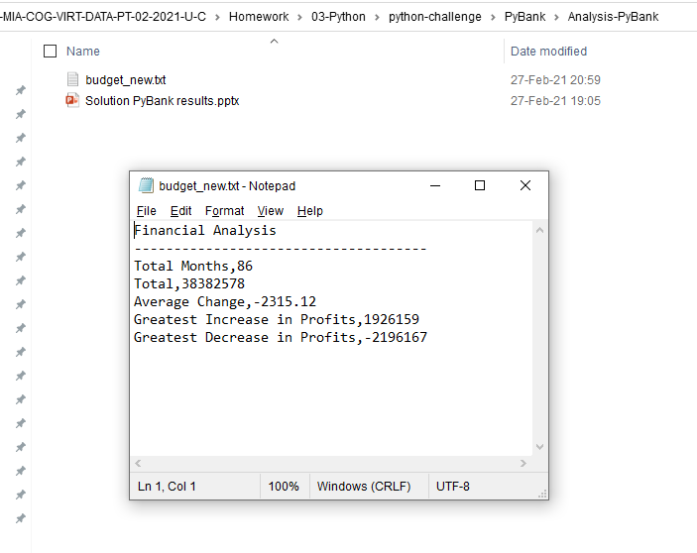
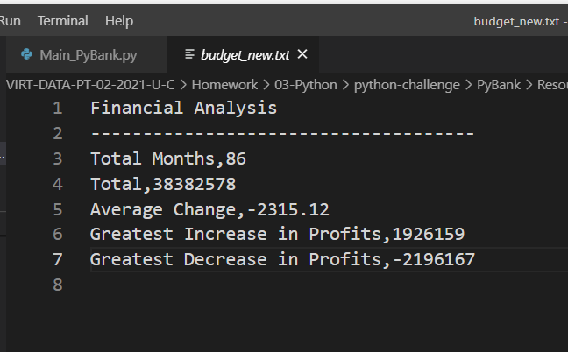
budget_new.txt with csv format exported

